Slide 1
Class 4 – Sept. 25
Writing code
Images
Rotation

Slide 2
Previously, in IMM120
Class Format Feedback
I’ll try to have everything graded by Friday.
If you send me URLs, I can be more constructive.

Slide 3
Previously, in IMM120
More Practice
Tutorials
YouTube: Daniel Shiffman
https://p5js.org/learn/
Coding Mindset Practice
Scratch – scratch.mit.edu
Games
Human Resource Machine
Files on Canvas
Lightbot – lightbot.com
Challenges
/r/dailyprogrammer/

Slide 4
Previously, in IMM120
WTF: Map
map(value, value minimum, value maximum, min output, max output);
Example: color of the sky, sunset

Slide 5
Previously, in IMM120
WTF: height / 2 ?
height

Slide 6
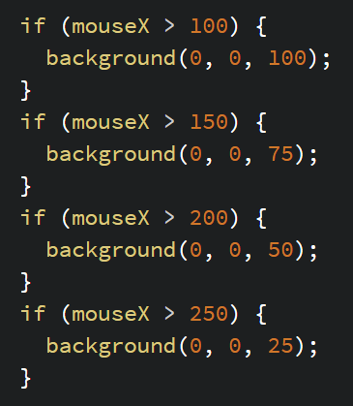
In-Place Math
mouseX | blue
100 | 100
150 | 75
200 | 50
250 | 25

Slide 7
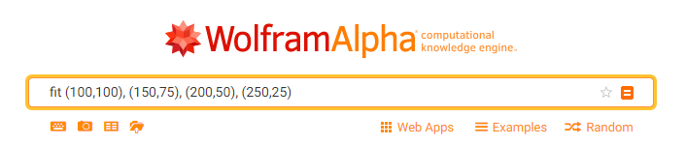

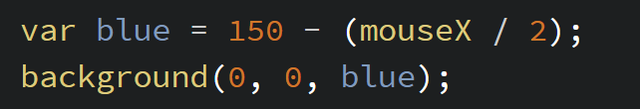
In-Place Math

Slide 8
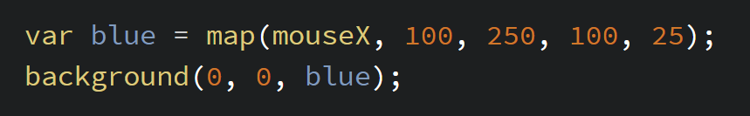
Map Instead of Math

Slide 9
More about Boolean Sentences
Boolean Conjunctions: Put between two comparisons, reduces them down to one boolean, creating what I’m calling “boolean sentences”.
&& (AND)
“The mouse is pressed AND the mouse is farther right than 200”
“This number is between these two.”
“This number is greater than one AND this number is less than two”
|| (OR)
“The mouse is pressed OR a key is pressed.”
“The bird is higher than this line OR the bird is lower than this line.”

Slide 10
Writing Programs

Slide 11
Syntax vs. Semantics
Syntax
Semantics
Syntax is the punctuation and the proper way to write code so a computer can translate it.
A syntax error may be:
Missing a semi-colon
Too many brackets
Too many or too few parameters
Semantics are what your code means and what it’s trying to accomplish.
A semantics error may be:
Using the wrong variable
Using < instead of >
Setting a variable wrong

Slide 12
Pseudocode
Write out the steps in English before you turn it into real code.

Slide 13
Fizzbuzz pseudocode
Start counting. Every time a number is a multiple of 3, say “fizz”. If it’s a multiple of 5, say “buzz”. If it’s both, say “fizz buzz”. If it’s none of the above, say the number.

Slide 14
Fizzbuzz pseudocode
Start counting at 1.
Every time a number:
is a multiple of 3,
say “fizz”.
If it’s a multiple of 5,
say “buzz”.
If it’s both,
say “fizz buzz”.
If it’s none of the above,
say the number

Slide 15
Where in the p5.js skeleton?
“Once at the start”: setup
“Every time this…”: draw
“Once when this input…”: event function
keyPressed(), mousePressed()

Slide 16
Fizzbuzz pseudocode
Set number to 1
In draw:
if number is a multiple of 3,
say “fizz”.
If number is a multiple of 5,
say “buzz”.
If number is a multiple of 15,
say “fizz buzz”.
If none of the above,
say number

Slide 17
Fizzbuzz pseudocode
Set number to 1
In draw:
If number is a multiple of 15,
say “fizz buzz”
else:
if number is a multiple of 3,
say “fizz”.
else If number is a multiple of 5,
say “buzz”.
else
say number

Slide 18
Fizzbuzz pseudocode
Set number to 1
In draw:
If number is a multiple of 15,
print(“fizz buzz”)
else:
if number is a multiple of 3,
print(“fizz”)
else If number is a multiple of 5,
print(“buzz”)
else
print(number)

Slide 19
https://cdpn.io/e/KXavez

Slide 20
% (modulo)
Returns the remainder of division
6 / 4 == 1.5 vs. 6 % 4 == 2
SUPER USEFUL
num % 2 == 0; // num is even
num % 7 == 0; // num is divisible by 7
count = count % 10; // number will loop 0-9

Slide 21
Organizing Code

Slide 22
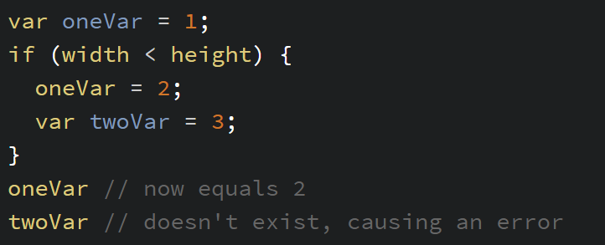
Code Blocks (Scope)
Things that are made between brackets, stay between brackets

Slide 23
Code Searches “Up” for Variables

Slide 24
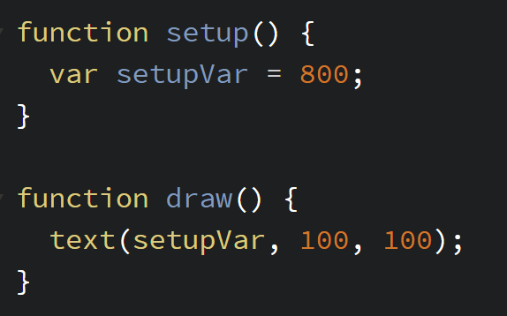
Scope and Functions

Slide 25
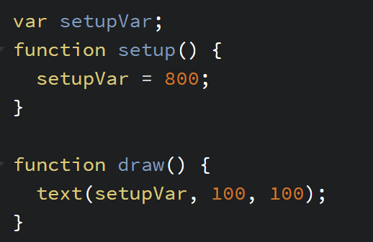
Scope and Functions
This is why we put the variables up top

Slide 26
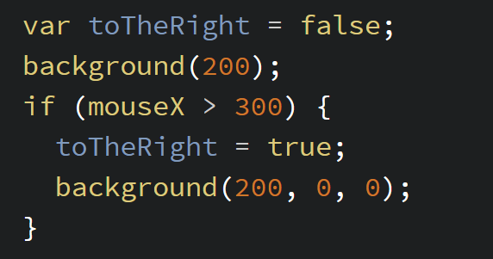
If-statements
Default
Special Case

Slide 27
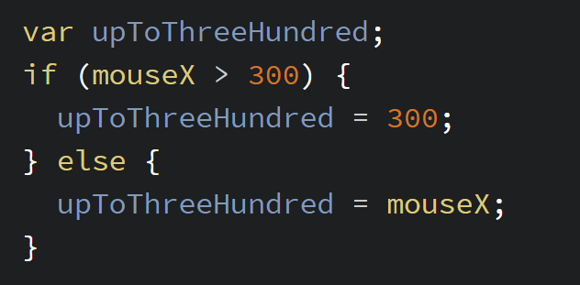
if-else statements
Make Variable
Set to this
Else this

Slide 28
Where Do I Put Things?

Slide 29
General Order
Math and calculations
Checks ie. touching edge, keydown, etc
Drawing
Resetting checks

Slide 30
Code that will be used more than once:
Put them in functions!
Easier to maintain and easier to understand what is happening.
A good goal is to repeat as few lines of code as possible.
Different from writing as few lines as possible.

Slide 31
Your Health While You Code
Since we’re talking meta…

Slide 32
Repetitive Stress Injuries
Form habits now, so you don’t have to later.
Practice good posture
Exercise your hands and wrists

Slide 33
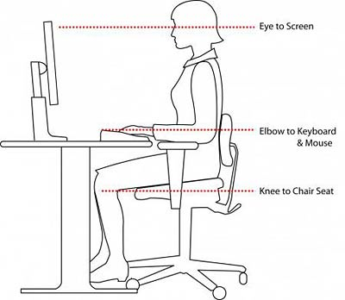
Four Ideal Levels
IDEALLY
Your eyes should be level with the top of your screen
Your wrists should be level with your elbows
Your knees should be level with the top of your chair
Your wrists should be straight (don’t have to be parallel)
Try to get these things where you code the most. Also, try standing, it’s really nice.

Slide 34
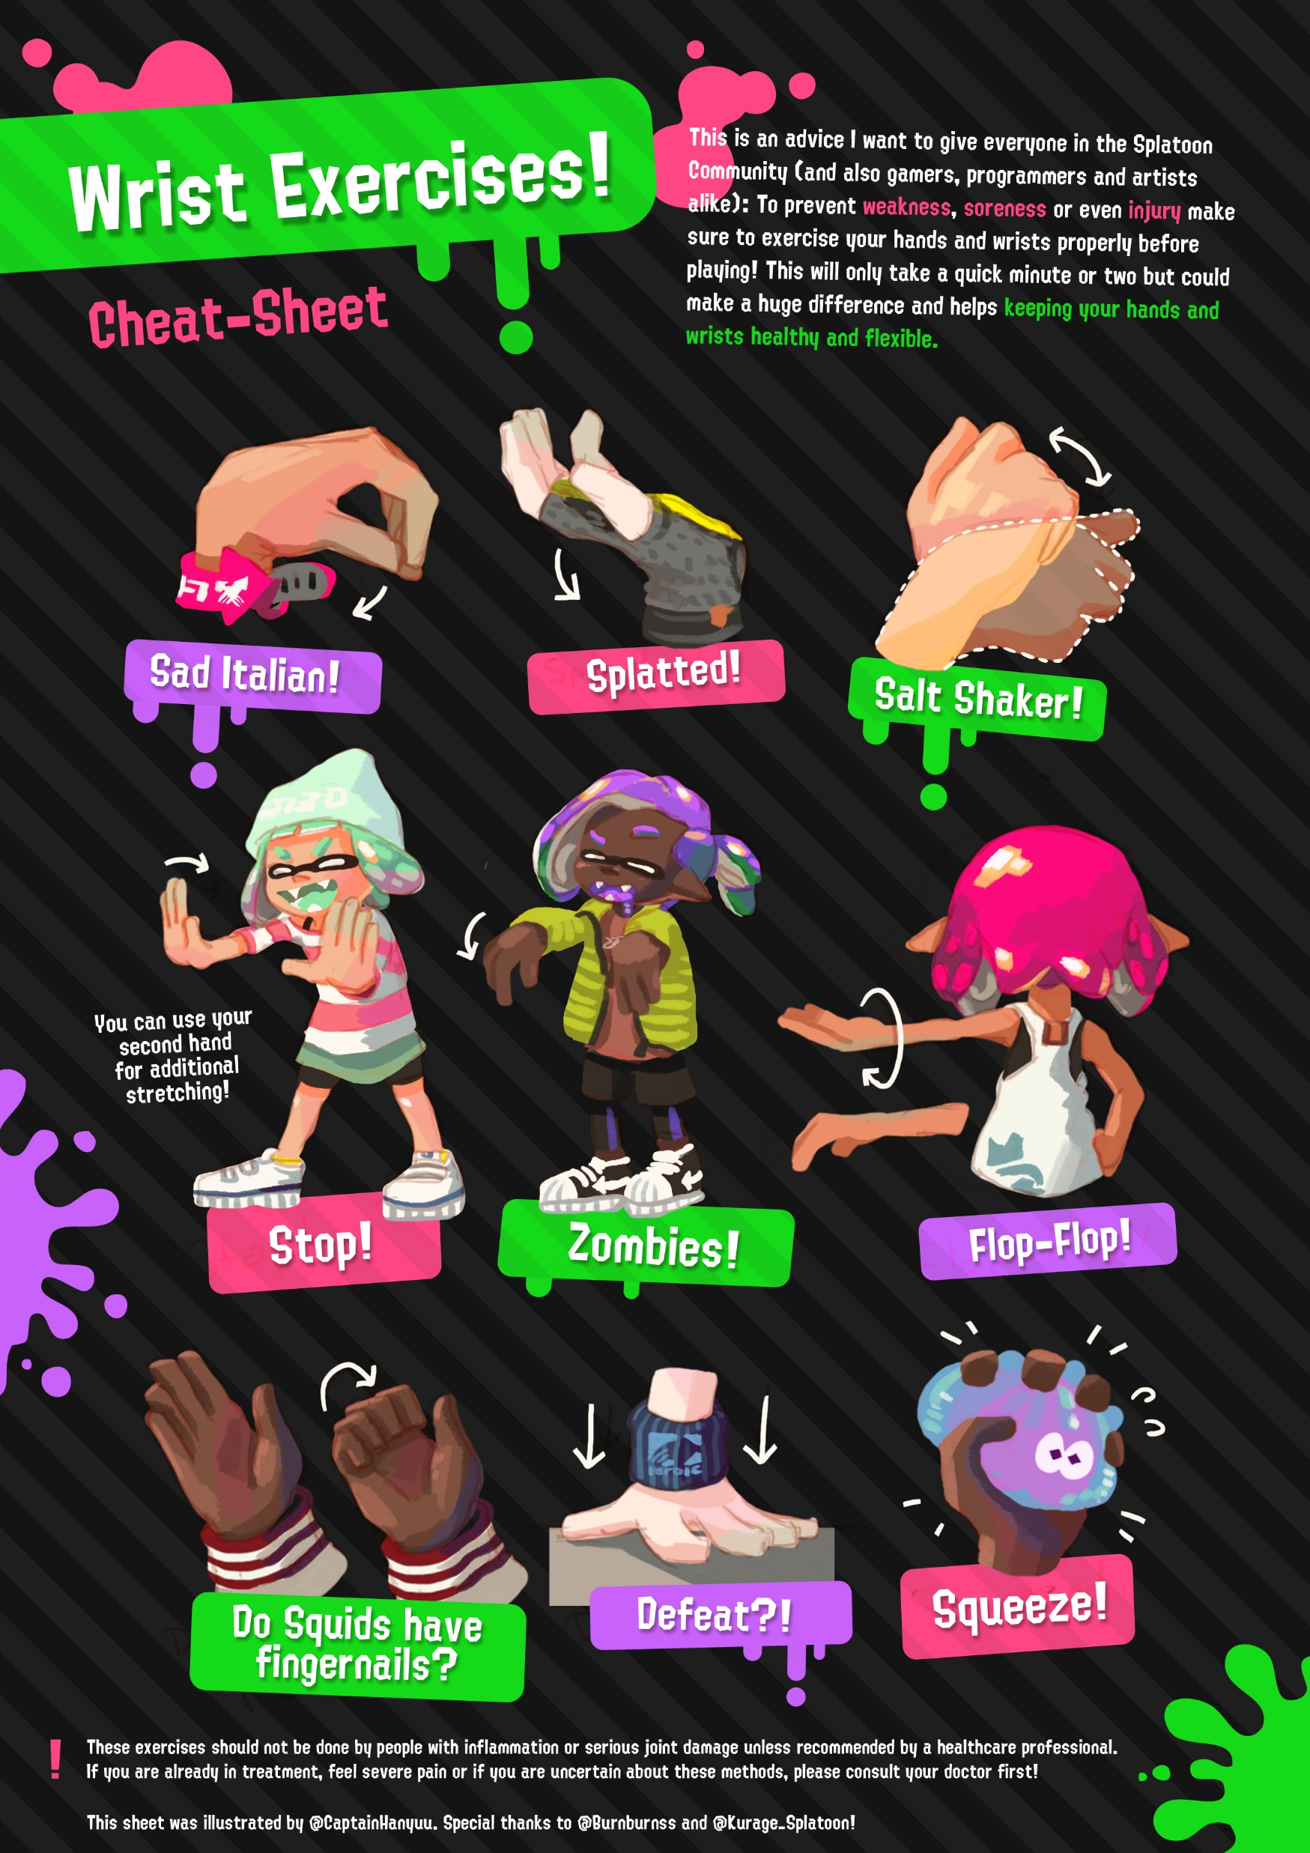

Slide 35
Debugging

Slide 36
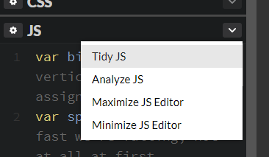
Remember Your Tools
print() to report the value of any variable
Codepen’s red alert
Browser Console
Inspect Element, click Console
Tidying your code

Slide 37
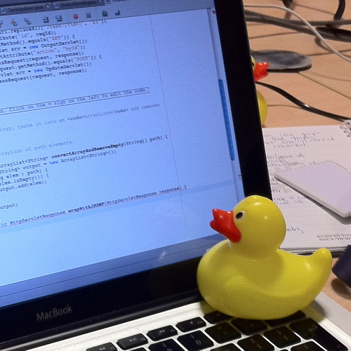
The Rubber Duck Method

Slide 38
Rubber Duck Debugging
The rubber duck debugging method is as follows:
Beg, borrow, steal, buy, fabricate or otherwise obtain a rubber duck (bathtub variety).
Place rubber duck on desk and inform it you are just going to go over some code with it, if that’s all right.
Explain to the duck what your code is supposed to do, and then go into detail and explain your code line by line.
At some point you will tell the duck what you are doing next and then realize that that is not in fact what you are actually doing. The duck will sit there serenely, happy in the knowledge that it has helped you on your way.
Note: In a pinch a coworker might be able to substitute for the duck, however, it is often preferred to confide mistakes to the duck instead of your coworker.

Slide 39
Rubber Duck Debugging - FAQ
If ducks are so smart, why don’t we just let the ducks do all the work?
It would be wonderful if this were true, but the fact is that most ducks prefer to take a mentoring role. There are a few ducks however that do choose to code, but these are the ducks that nobody hears about because they are selected for secret government projects that are highly classified in nature.
Where can I learn more about rubber duck debugging?
More information can be found at rubberduckdebugging.com, wikipedia.org, lists.ethernal.org, and zenhub.com.
Where can I hire my own duck?
Great question! Amazon.com hosts a wide selection of affordable ducks that have graduated with a technical degree from some of the world’s leading universities.

Slide 40
https://cdpn.io/e/ZXBrZw
Debug Challenge
There are 6 things wrong, some semantic, some syntactic.
Notes:
Answer: https://codepen.io/crhallberg/full/gGLvqW

Slide 41
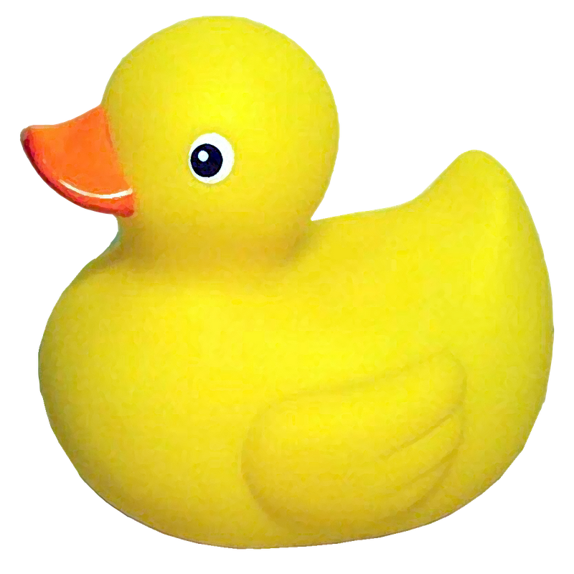
I am here to help

Slide 42
Text

Slide 43
Flappy Bird Score
https://cdpn.io/e/veNQJo
No longer part of the homework, here’s why.

Slide 44
Images

Slide 45
https://imgur.com/mWtIlB1
Flappy Bird image

Slide 46
Rotation

Slide 47
2*PI
TWO_PI

Slide 48
Moving the Grid
push(); - Make a checkpoint
pop(); - Go back to the last checkpoint
translate(dx, dy); - Move the origin dx left and dy down
rotate(rads); - Rotate the canvas around the origin
Notes:
Use map. Refer atan to reference

Slide 49
Homework
There’s no homework so you can check out the tutorials I mentioned earlier
Flappy Bird is due on Wednesday

Slide 50
More Practice
Tutorials
YouTube: Daniel Shiffman
https://p5js.org/learn/
Coding Mindset Practice
Scratch – scratch.mit.edu
Games
Human Resource Machine
Files on Canvas
Lightbot – lightbot.com
Challenges
/r/dailyprogrammer/
Notes:
FLAPPY BIRD ON WEDNESDAY
Thank you, Lillian, for the music suggestions. Add yours on the Canvas discussion!

Slide 51
Minute Surveys
ON THE BACK
Draw a circle and mark: 0 radians, 45 degrees, PI radians, -PI / 3 radians

Slide 52
Placing a Point at an Angle
ORIGIN
ANGLE
DISTANCE
sin(angle) * distance
ORIGIN
cos(angle) * distance

